Slide 1


Women Researchers in Informatics (WRI)
Toktam Ramezanifarkhani
toktamr@ifi.uio.no

Slide 2
The Initiative
Established: fall semester 2019, Women Researchers in Informatics Network
To: activities to empower women researchers to
achieve their full potential, and
make the informatics department a more balanced and a better work environment for all its employees.
Target: the main targets are female researchers at all levels:
PhD, PostDocs, Researchers, Professors.
We are also open to other members, master students and male researchers interested in the topics

Slide 3
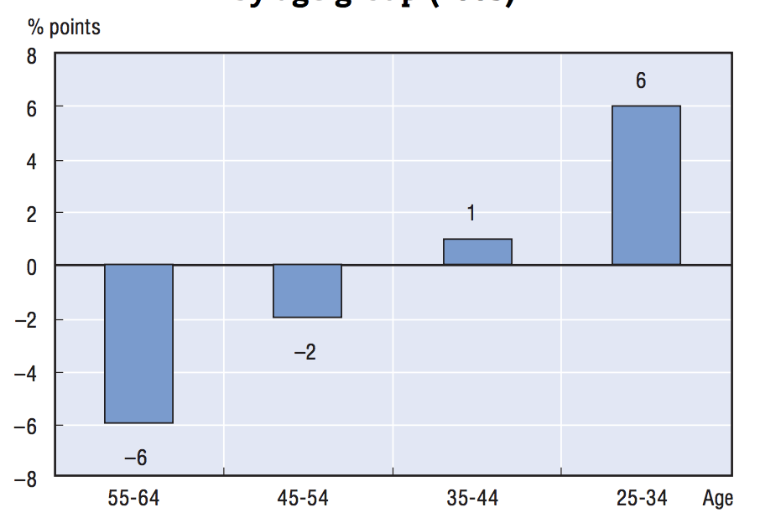
Why - Challenges
Studies all around the world: Inequality in academia
Gap between female and male tertiary educational attainment by age group (2005)
the reason for gender inequalities?
Demographic factors and Sociological factors
Combining having a family with professional life
Gender-oriented parental model and changes in the composition of families
Economic factors
Reduction in discrimination in the labor market
Vincent-Lancrin, S. (2008). The reversal of gender inequalities in higher education: An on-going trend.
Notes:
Higher return on studies in higher education and degrees for women
Alternative choices and structure of economies

Slide 4
scissor-shaped curve
The literature on “gender and science” underlines how much careers in science and academia are still subject to discrimination according to the sex. This becomes visible in the famous scissor-shaped curve, where one can observe a progressive “evaporation” or disappearance of women as they advance in the career; an occurence, which is called the “leaky pipeline” phenomenon.
Limited time in a temporary job
Grow the other branches of life – age limitations
Families: Kids, partners, single parent
Not a student, not a professor
Imposter Syndrome
Herschberg, C., & Berger, L. J. (2015). Academic careers and gender inequality: Leaky pipeline and interrelated phenomena in seven European countries. Trento: University of Trento.
Women in Academia: Quick Take, Jan 23, 2020
Notes:
Dangling reference
You are good but not good enough!
Imposter Syndrome
Dont give up
Keep the fire warm

Slide 5
Goal
Grow the network toward having:
meaningful and qualified scientific life
Dear Academia,
...

Slide 6
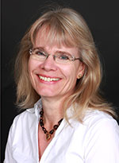
Contact
FRONT- A project to promote equality and gender balance (https://www.mn.uio.no/om/likestilling/front/)
Grants:
Marthe Amundsen (https://www.mn.uio.no/om/likestilling/front/kontaktinformasjon.html)
Solveig Kristensen Prodekan

Slide 7
How – to reach the goal (1)
Entrepreneurship:
Our guest speaker was the CEO of the Norwegian Chapter of the Founders Institute.
Personal Experience Sharing - Successful in Academia, Successful in Research, Successful in Industry
Recipient of the Young Research Talent- Frippo
Recipient of ERC
Mentorship
Organizing mentorship pairings between senior female PhD researchers/PostDocs/Professors and junior PhDs.

Slide 8
How?!... (2)
Find innovation and commercial potential in your research
Find help and assistance for innovation at the university?
Collaboration with business, organisations and public administration such as Inven2 As and OsloTech As, etc
Student activities in innovation such as StudEnt, Start UiO and Insj UiO?

Slide 9
How?!... (3)
Coping with the psychological effects of working at home
balancing personal life and career in crisis
Work at home
Pandemic
Anxiety and ...
Speakers ladies from Postdoc training center in Australia, Physicology UiO
Preparation for Academic Jobs after PhD,
Roman and UiODoc
10 – 70 participants

Slide 10
Activities - Until now
Collaborations between experts in different scientific fields for further and interdisciplinary research
it is a trend
is not that common in our conferences and events
Attend the more prominent communities with the same goal such as IEEE women research and engineering,
Arrange national and international workshops that female experts can share their knowledge,

Slide 11
Step forward
Share personal experiences on working at UiO,
Areas of interest that you would like to address as part of the WRI network
WRI team
Events Officer - coordination and invitations,
Advisory committee - needs and options and networking,
Dissemination officer - web pages and announcements,
Other activities - Financial management.
E-mail: toktamr@ifi.uio.no
https://www.mn.uio.no/ifi/english/research/networks/wri/
Notes:
https://www.catalyst.org/research/women-in-academia/

Slide 12
Activities – look forward
Have more synergies with department-level graduate and undergraduate women
Empowerment initiatives
Expand the initiative to other departments
Continue with the seminar series and the mentoring program
Connect with other European and international networks

Slide 13
meaningful scientific life
inform female researchers that attend UiO, ifi as part-time researchers and need some information and support about the options and obligations in particular issues such as pregnancy, exchange, etc,
arrange national and international workshops that female experts can share their knowledge,
invite successful women who may need to travel and possibly stay for a couple of days,
to attend the more prominent communities with the same goal such as IEEE women research and engineering,
to grow our communication and collaboration for further research and educational transitions.

Slide 14
Research
Proposal
Young Research Talent Proposal – submitted, 2020,
ERC 2021,
Course development involving students, grant from center for computing in science education (CCSE), granted 2020.
“Women Researchers in Informatics Network" (WRI), granted 2020.
M.S. student main supervisor
Lara Okafor, social engineering attacks
Nora Elisabeth Pålsrud (Simula: Towards Automated Repair of Security Vulnerabilities)
Talha Wazir Khan, Malware analysis - ransomware survey IOT,
Atiqur Rahman, Machin learning for driver authentication,
Krishant Baral Pokharel, Software Security in Agile Software Development Process
Erik Erdahl Lange, Machine learning for Industrial Usage (Combination of Pipelines for Testing)
Notes:
interdisciplinary innovation is humanitarian assistance in security issues of smart devices by providing secure software sytem and application
Combining vulnerability scanner,
Specification of Programming languges with security policy specification while the compiled programs can enforce that policy,
Smart devices,
User as a key part of the system ...

